Slide 1

Lecture 10 Applications/Deep Learning
COMP3204 & COMP6223 Computer Vision
Where is feature extraction used these days?
 | Book pp 250-258; 271-279

Slide 2
Content
Where is computer vision going?
Where and how is it used?

Slide 3
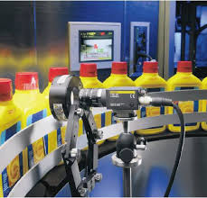
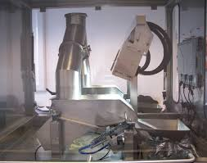
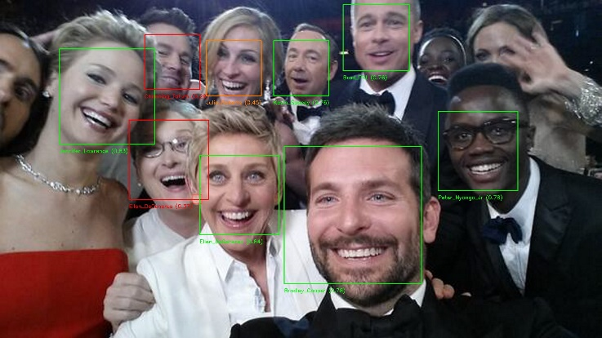
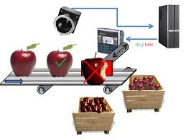
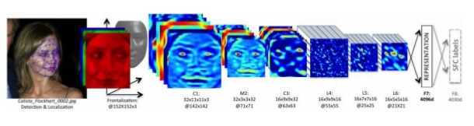

Where is computer vision used?
What you see depends on the viewpoint you take
Academics,
but increasingly everyone
Industry

Slide 4
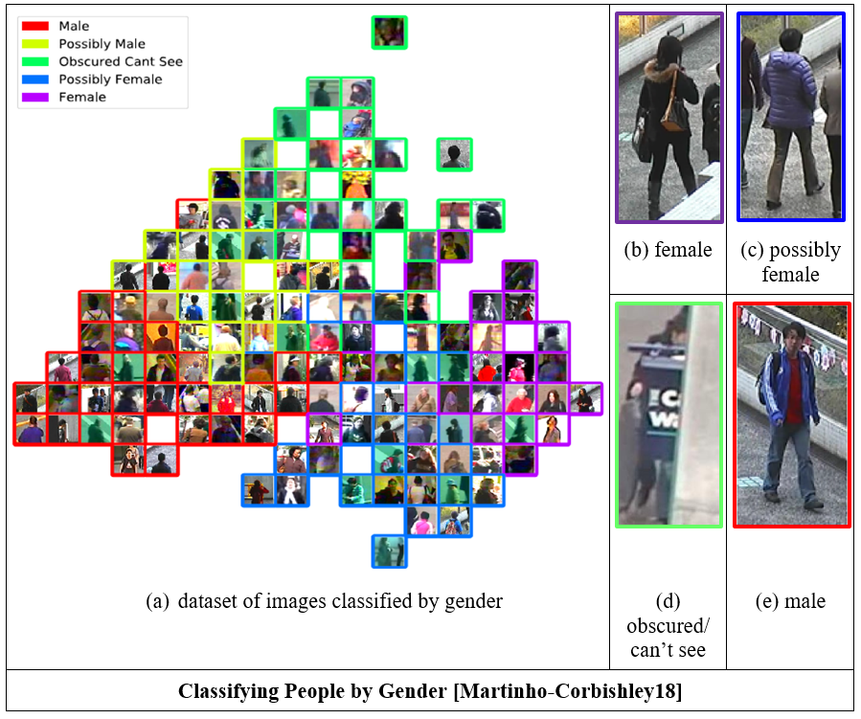

Slide 5
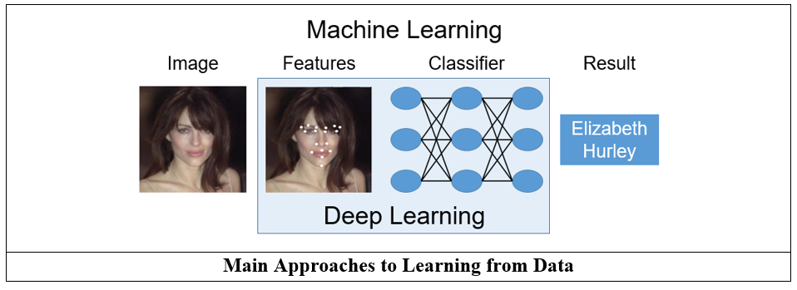
On learning

Slide 6
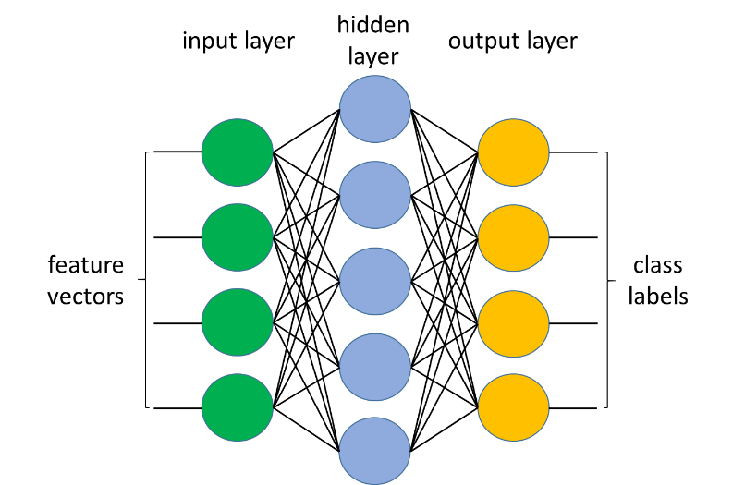
80’s

Slide 7
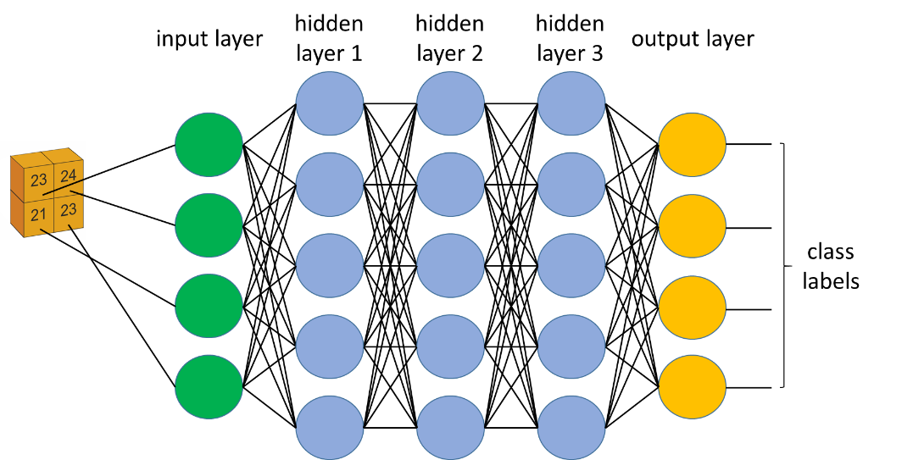
Basis of a Deep Neural Network

Slide 8
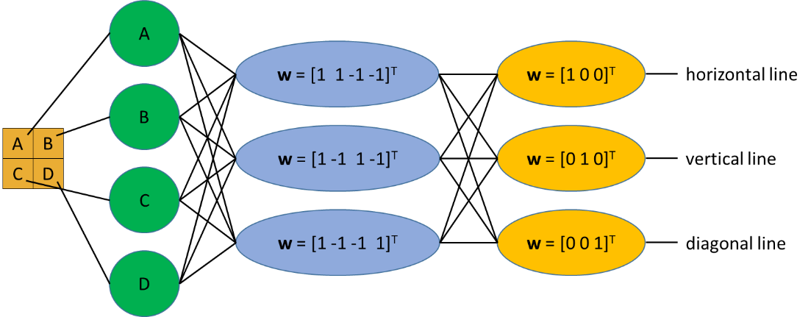
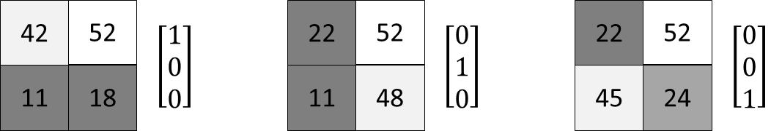
Trained Example Neural Network

Slide 9
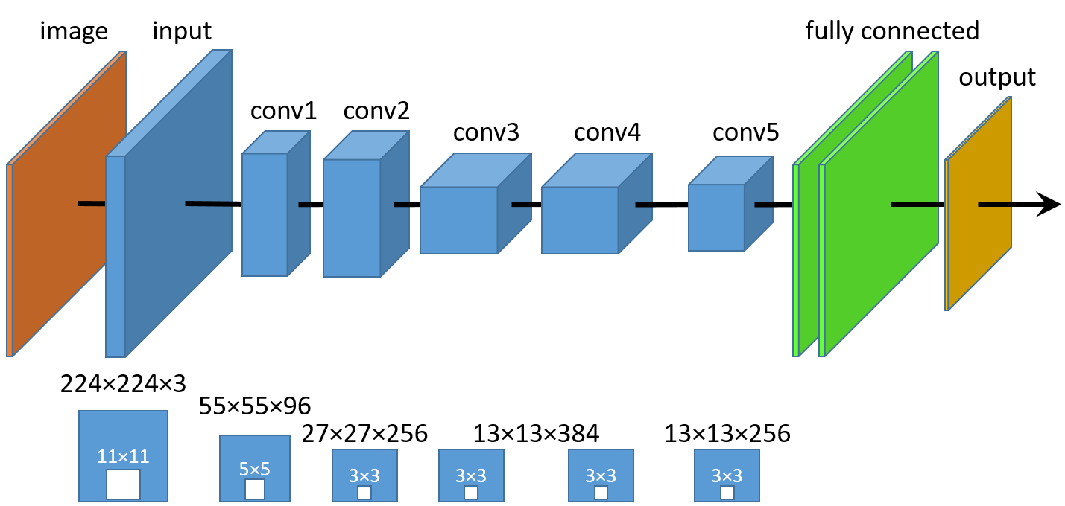
Alexnet architecture

Slide 10
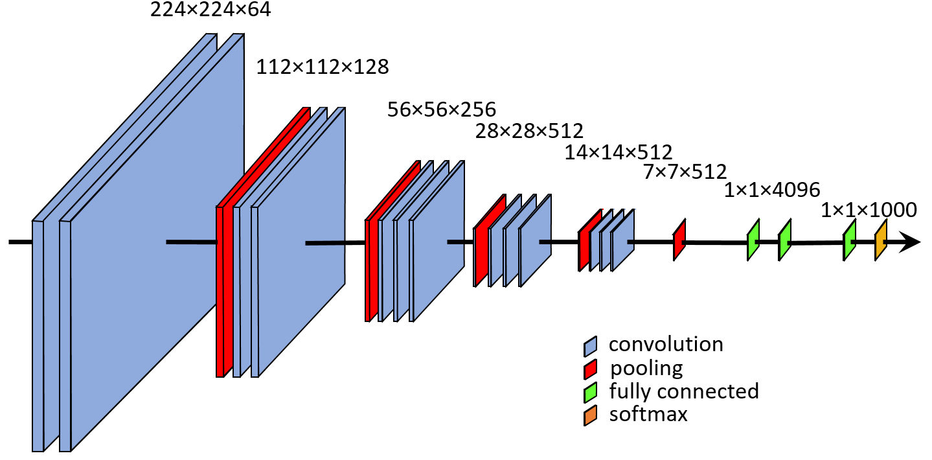
VGG architecture

Slide 11
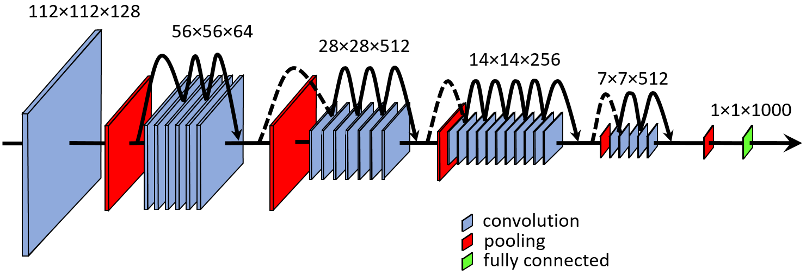
Resnet architecture

Slide 12
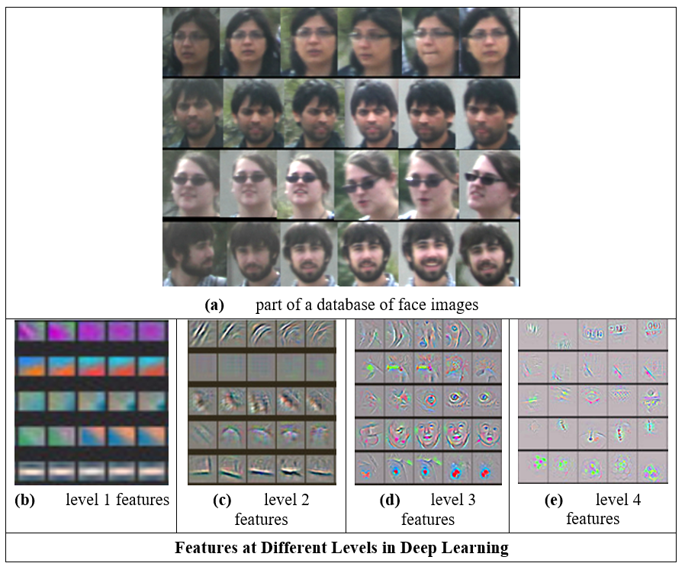

Slide 13
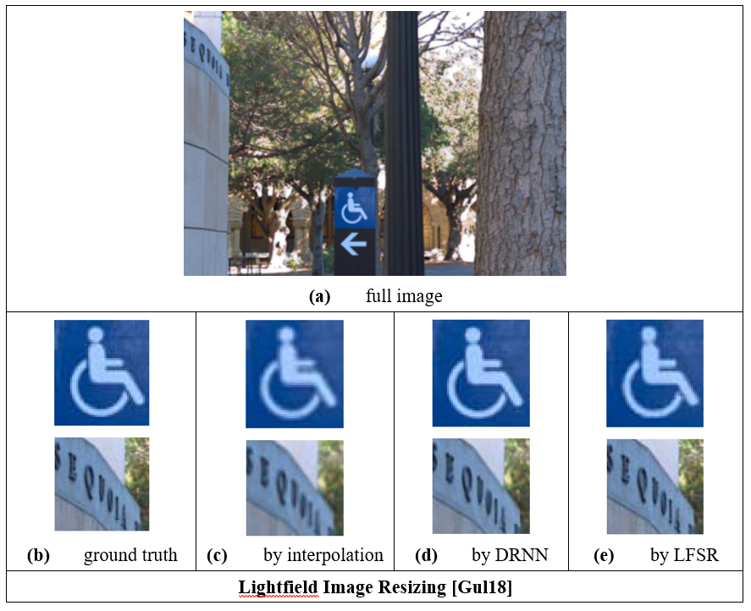

Slide 14
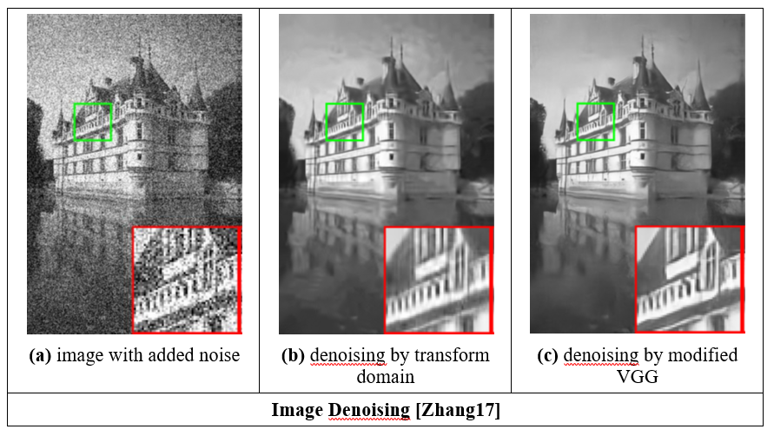

Slide 15
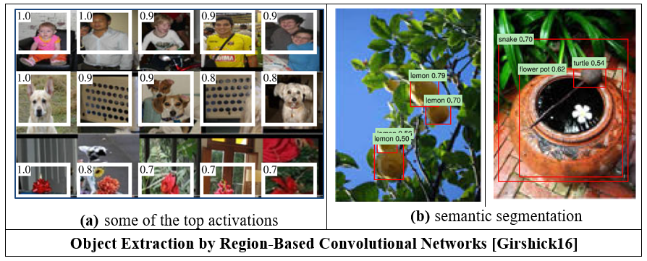

Slide 16



Motivation: Murder case in Australia 2014
Bouchrika, Nixon, Carter, J. Forensic Science 2011, and Eusipco 2010

Slide 17
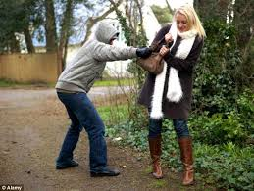
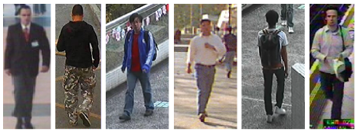
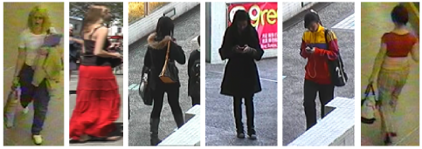
Automating eye witness statements
Image of crime
Eyewitness statement
Generate description
“24 year old male average height
wearing shirt”
Subject | Gender | Age | Height | Nose W | Top
? | M | 24 | 171 | 2.4 | Shirt
Database of images
Subject | Gender | Age | Height | Nose W | Top
123456 | M | 25 | 172 | 2.3 | Shirt
123457 | F | 36 | 156 | 2.2 | Blouse
123458 | M | 58 | 182 | 1.2 | T shirt
Database of descriptions
Generate descriptions
Notes:
This is zero shot ID. We want to go from description to identification.
The main question here is what can we learn from human vision. We don’t impose categories and see how much the image matches them. We do ID by asking for fine grained semantic categories, and then see if we can learn them from the images.
Note that Re-ID is largely about image matching and needs images from same viewpoint. It’s not attribute based search as ours are fine grained.

Slide 18

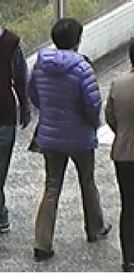

Gender estimation on PETA
Gender?
Subject | 1 | 2 | 3
PETA image
Male
Female
Male
Female
Male
Female
PETA label
Male
Female
Male
Female
Male
Female
Martinho-Corbishley, Nixon and Carter, Proc. BTAS 2016
Notes:
Answer is clear. Short, long hair, handbag, shopping. Child besides?
Answer is unclear, Peta label is man but it is more likely to be a woman. Note the shoes and that dreadful coat.
This is nonsense. It doesn’t happened much, but it does. There should be don’t know cases. Gender is not so easy.

Slide 19



Gait-based Age Estimation using a Whole-generation Gait Database
How old is he/she?
Subject | 1 | 2 | 3
Gait
Age
62 years old
72 years old
82 years old
24 years old
34 years old
44 years old
4 years old
14 years old
24 years old
62 years old
72 years old
82 years old
24 years old
34 years old
44 years old
4 years old
14 years old
24 years old
Makihara, Okumura, Iwama, and Yagi, Proc. IJCB 2011
Notes:
Let’s start with quiz.
Please guess his or her age by gait.
For the first subject, please raise your hand for your choice.
4 years old?
OK, so the answer is A. 4 years old.
This was probably a easy question.
So, the second subject, please choose in the same way.
62 years old?
The answer is C. 82 years old.
The last one maybe a little bit difficult, but please try to guess.
24 years old.
The answer is B. 34 years old.
Anyway, we can feel possibility of gait-based age estimation from these examples.

Slide 20

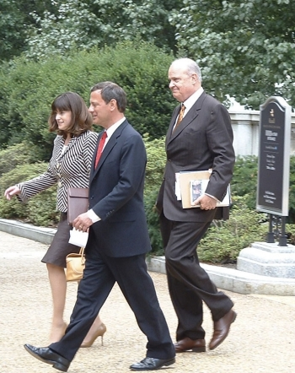
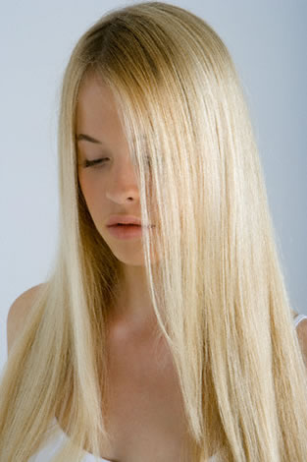
Traits and terms
Body Features
Based on whole body description stability analysis by MacLeod et al.
Features showing consistency by different viewers looking at the same subjects
Mostly comprised of 5 point qualitative measures
e.g. very fat, fat, average, thin, very thin
Most likely candidate for fusion with gait
In biometrics, gender and sex are synonymous. ‘Assigned sex’ might be preferred to ‘gender’ in general use.
Global
Sex
Ethnicity
Skin Colour
Age
Body Shape
Figure
Weight
Muscle Build
Height
Proportions
Shoulder Shape
Chest Size
Hip size
Leg/Arm Length
Leg/Arm Thickness
Head
Hair Colour
Hair Length
Facial Hair Colour/Length
Neck Length/Thickness
This changed
Samangooei, Guo and Nixon, IEEE BTAS 2008
Notes:
5 point likert scale wel established. But it’s for categorical traits

Slide 21
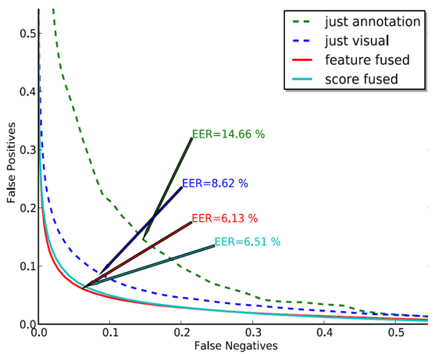
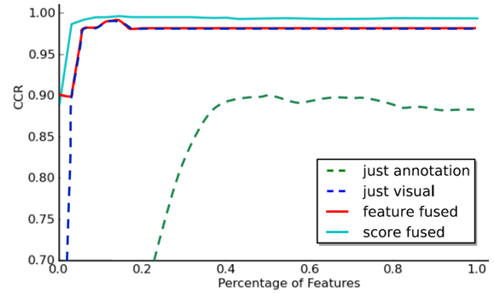
Human descriptions: recognition capability
Gait biometrics
Human descriptions
First result
Samangooei and Nixon, IEEE BTAS 2008

Slide 22
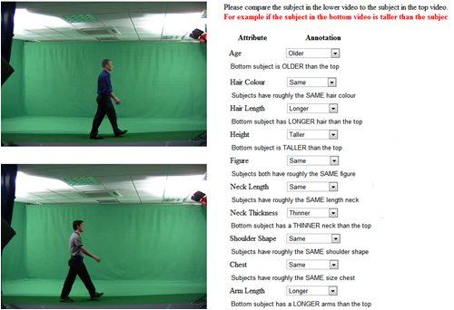
Comparative human descriptions
Compare one subject’s attribute with another’s
Infer continuous relative measurements
Reid and Nixon, IEEE ICDP 2011, TPAMI 2014

Slide 23
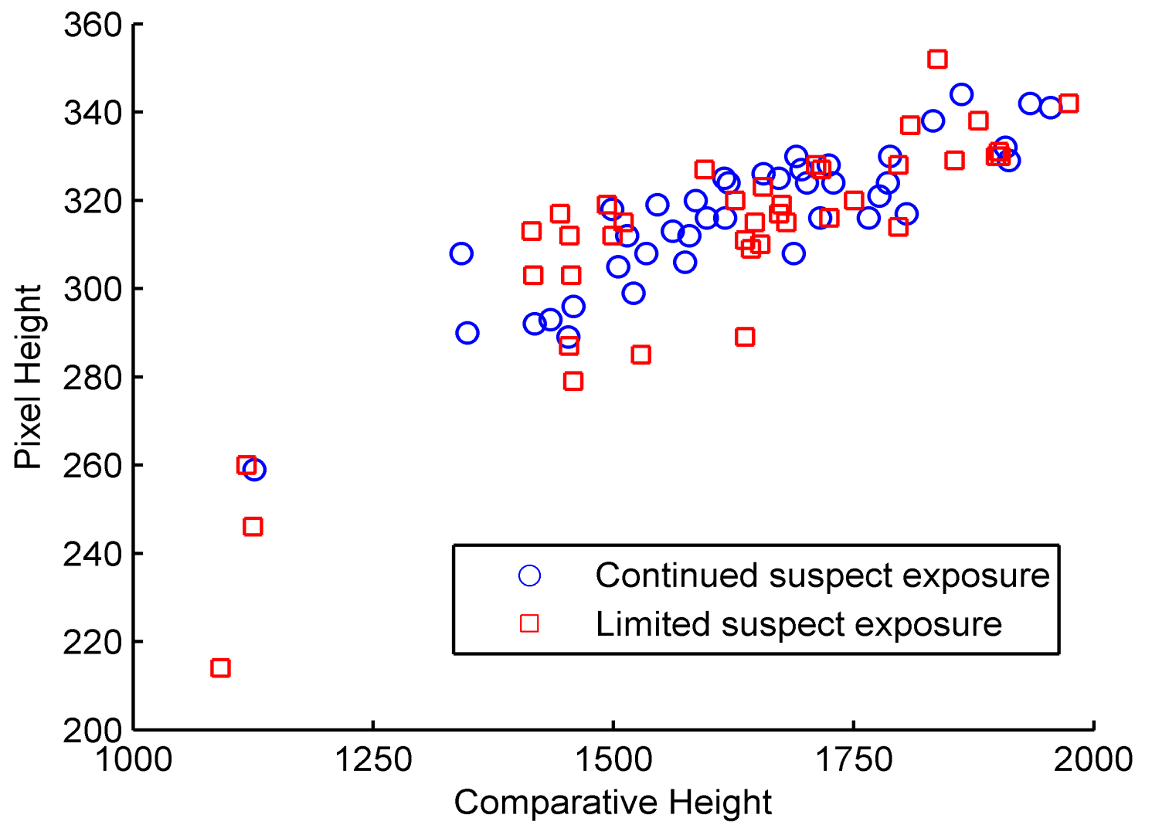
Height correlation (with time)
Reid and Nixon, IEEE ICDP 2011, TPAMI 2014

Slide 24
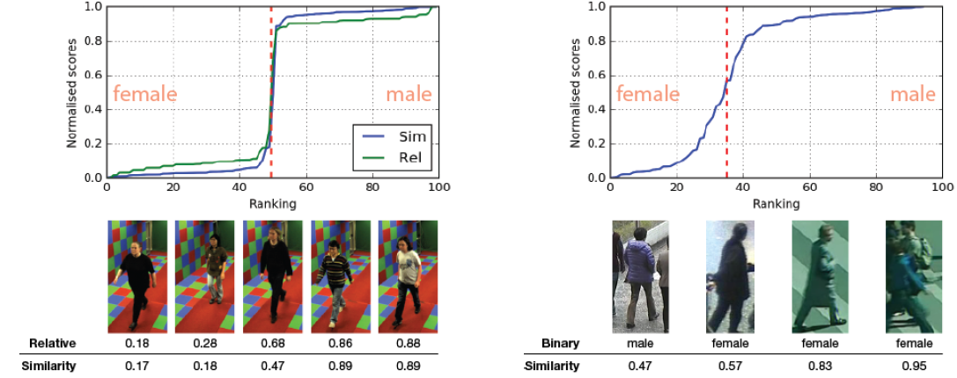
Pairwise similarity comparisons on PETA
Normalised scores
Normalised scores
Ranking
Ranking
Gender distribution not binary
Can measure confidence
Martinho-Corbishley, Nixon and Carter, BTAS 2016
Notes:
Question is then how do we improve or analyse these labels by image comparison. In Figure we observe highly analogous relative and similarity scores of SoBiR’s 100 subjects. Although collected through two disparate forms of comparative visual annotation, scores vary, with a Spearman’s rank correlation coefficient of =0:84. Furthermore, the dataset’s most gender ambiguous subjects obtain identical ranks and similar relative scores. This suggests our methodology is at least as informative as an ordered comparison approach [14].
Figure 3b visualises the crowd’s gender perception from a subset of PETA. Lower quality and more obscure images produce a shallower, less divisive, slope. We find a proportionally similar female-male split to the binary ground truths, with the only four conflicting measures highlighted.
his is nonsense. It doesn’t happen much, but it does. There should be don’t know cases. Gender is not so easy.

Slide 25
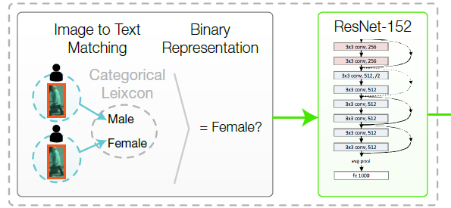
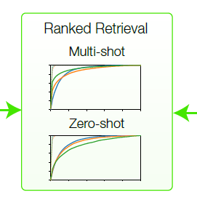
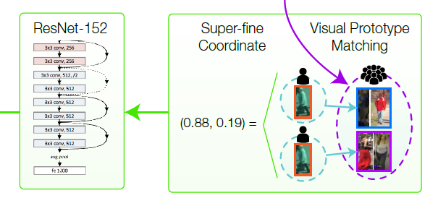
Conventional attribute-based analysis
Retrieval architecture
Superfine attribute analysis
Martinho-Corbishley, Nixon and Carter, IEEE TPAMI 2019

Slide 26
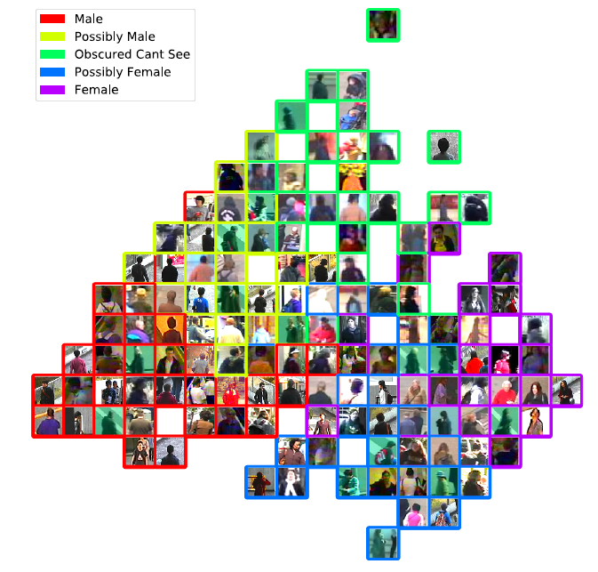
Gender
Martinho-Corbishley, Nixon and Carter, IEEE TPAMI 2019

Slide 27



Analysing gender (??!!)
Gender?
Subject | 1 | 2 | 3
Male
Female
A. Male
B. Female
Male
Female
Male
Female
A. Male
B. Female
Gender
Male
Female
Notes:
Image taken from google on “ladyboy”. Definitely male from other images of same person (!!!! Not shown here!!!)
Traditional dress implies femal
Ladyboy of the year. How do they measure that??

Slide 28
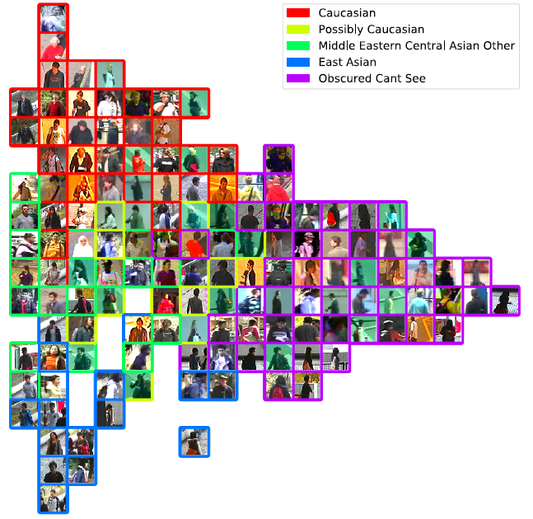
Ethnicity
Martinho-Corbishley, Nixon and Carter, IEEE TPAMI 2019

Slide 29

Takeaway time
1 – computer vision works and has a great future
2 – big difference between hand crafted and deep learning
3 – some parts are the same (group operators/ templates)
4 – what will happen in the future?
Jon Hare will happen in the future!
Beyond that, I can only speculate. Enjoy!
Notes:
J&S fish

